Slide 1
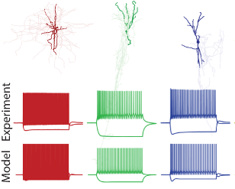
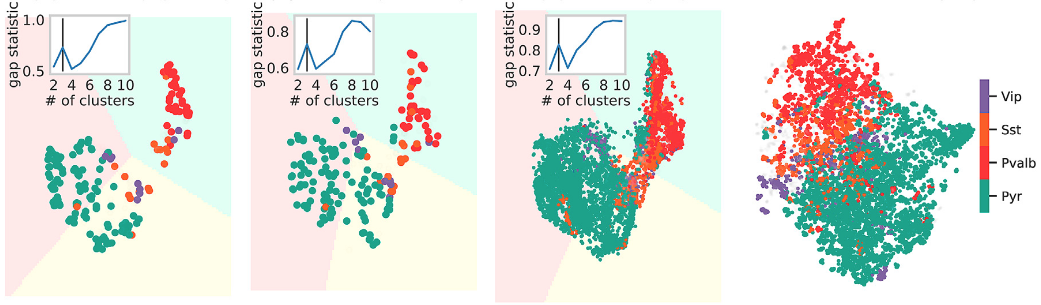
experiments
models
model parameters
experiment
model

Slide 2
experiment
model

Slide 3
experiments
models
model parameters
experiment
model

Slide 5
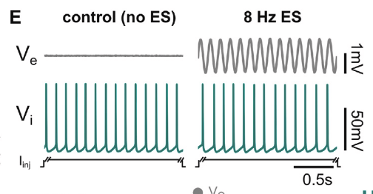
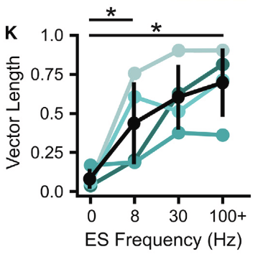
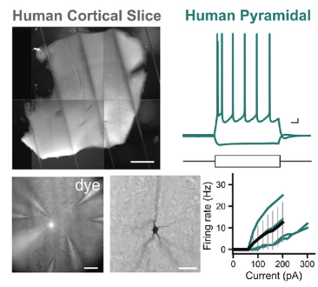
human pyramidal neuron
spike entrainment (norm)
stimulation freq / Hz

